Slide 1
Progress update on Health and Care Integration: National, Regional (North West London) and Locally in Harrow
Lisa Henschen, Managing Director, Harrow Borough-Based Partnership
Isha Coombes, Borough Director (Harrow), North West London CCG

Slide 2
National position

Slide 3
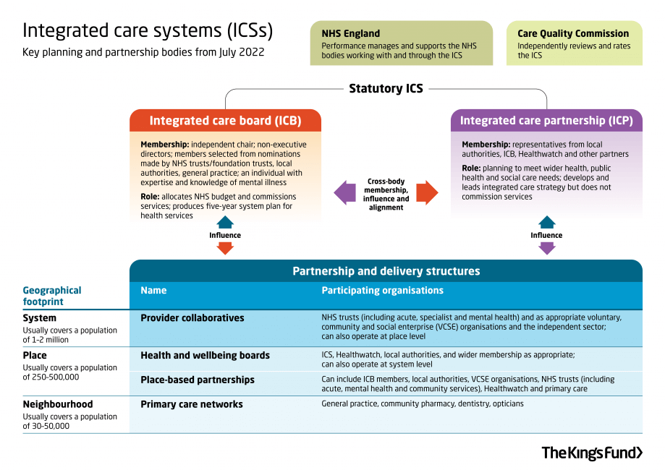
Health and Care Bill: Integrated Care
System working towards integrated care has been underway for many years. It will now be formally cemented in Legislative Framework through the Health and Care Bill.
The statutory ICS will be made up of two key bodies:
Integrated care board (ICBs) will take on the NHS planning functions previously held by clinical commissioning groups (CCGs) and are likely to absorb some planning roles from NHS England.
Integrated care partnerships (ICPs) will operate as a statutory committee, bringing together the NHS and local authorities as equal partners to focus more widely on health, public health and social care. ICPs will include representatives from the ICB, the local authorities within their area and other partners such as NHS providers, public health, social care, housing services, and voluntary, community and social enterprise (VCSE) organisations. They will be responsible for developing an integrated care strategy, which sets out how the wider health needs of the local population will be met.

Slide 4
Moving to the Integrated Care Board
The Integrated Care Board will begin on 1 July 2022.
What happens to NW London CCG?
The CCG will continue (as a statutory body with all existing duties and functions) until 30 June 2022
CCGs will be disestablished under the Act, and their functions will be largely subsumed into the functions of the ICS bodies
Governing bodies will cease to exist on abolition of CCGs
All CCG staff will transfer to the NW London ICB under TUPE (Transfer of Undertakings (Protection of Employment)) regulations. (Following staff consultation)
1 July is just the beginning
North West London will seek to shape the new organisation together; staff, stakeholders and communities. This will start with the constitution and five year plan

Slide 5
North West London (regional) position

Slide 6
The North West London Integrated Care System
The North West London vision is to improve people’s life expectancy and quality of life, reduce inequalities and achieve health outcomes on a par with the best global cities. They have four key objectives as set out nationally by NHS England:
Improve outcomes in population health and health care
Prevent ill health and tackle inequalities in outcomes, experience and access
Enhance productivity and value for money
Support broader economic and social development

Slide 7
There are nine core programmes to deliver this vision
Four delivery programmes 1 Improving health and reducing inequalities in health |  | Five enablers 5 Workforce
2 Local care including primary care |  | 6 | Research and innovation
3 Mental health and care for people with learning disabilities and autism |  | 7 | Digital
4 Acute care: • Urgent and emergency Elective (high volume/low complexity, outpatients and diagnostics) Critical care Specialist (low volume/high complexity care) |  | 8 9 | Data Finance and estates
There are also a number of clinical networks focused on specific groups of people/patients, these include:
Maternity, children and young people
Support for people with long term conditions
Elderly people and end of life care
Cancer

Slide 8
The Integrated Care Board brings together partners and leaders from across the ICS. The board has statutory responsibility for NHS expenditure
NW London Integrated Care Partnership (quarterly) Chair: Penny Dash
Develop overall strategy to meet the wider health, public health and social care needs inc. goals to reduce inequalities and economic development (built from local borough based needs assessments, e.g. JSNAs)
Align purpose, ambitions and strategy of partners
Challenge all partners to demonstrate progress in reducing inequalities and improving outcomes
Develop approach to consultation and engagement
Refer decisions back to Integrated Care Board as appropriate.
NW London Integrated Care Board (monthly) Chair: Penny Dash
Develop a plan to meet the health needs of the population (based on the ICP’s strategy)
Allocate NHS resources to deliver the plan and deliver financial sustainability
Establish joint working arrangements to deliver the plan
Assure plans and metrics in place to review delivery against strategy
Agree capital plan for NHS
Secure the provision of health services
Hold all parts of system to account for delivery of ICS objectives and ICS programmes (where NHS funds are used)
Plan for, respond to and lead recovery from incidents
Support collaborative problem solving and drive transformation.
Eight LA Leaders and eight LA CEOs (Every 6 weeks) LA/ICS engagement
Discuss all major proposals
Support collaborative system problem solving and improvement.
NW London Chairs (monthly) Chair: Penny Dash
Engagement of NHS Chairs and LA leaders
Support collaborative system problem solving and improvement.
KEY: Blue boxes - statutory bodies Orange boxes - non statutory

Slide 9
Harrow position

Slide 10
The Harrow Borough Based Partnership
Borough Based Partnerships will be critical drivers of change in the new system.
The Harrow Borough Based Partnership brings together our NHS organisations, Harrow Council, our GPs, and local Voluntary & Community Sector.
We strive to support each
other and our communities as
equal partners focussing on
better health and wellbeing for all.
NHS North West London Clinical Commissioning Group
Harrow Council
Harrow’s Primary Care Networks
NHS Central London Community Healthcare NHS Trust
NHS Central and North West London NHS Foundation Trust
NHS London North West University Healthcare
Harrow Community Action
Harrow Health Community Interest Company
St Luke’s Hospice

Slide 11
Harrow Borough Based Partnership Governance Structure
Decision making
Statutory Body
Provider Boards
ICS
Staff advisors
Citizen advisors
Harrow Joint Management Board
Integration operational leads team
Harrow Health and Care Executive
Harrow Health and Social Care Senate
Neighbourhood integration function (x 5 PCNs)
Transformation workstreams
Health Overview and Scrutiny Committee
Council Cabinet
Health and Wellbeing Board

Slide 12
Decision-making Structure in the Harrow ICP
Sovereign Organisational Governance and Decision Making
Local Authority
Provider Boards
ICS
Primary Care Networks
Harrow Community Action
St Luke’s Hospice
Harrow Health CIC
Agreed level of delegated responsibility (to be defined in Terms of Reference)
Harrow Joint Management Board
Agreed level of delegated responsibility (to be defined in Terms of Reference)
Harrow Health and Care Executive

Slide 13
Our mission
Working with children, families and communities in Harrow to support better care and healthier lives

Slide 14
Delivery framework and partnership priorities

